Slide 1
DBMS Mini Project
on MySQL Workbench

Slide 2
Case Study
Retail Banking Case Study
Customer schema Case Study

Slide 3
Retail Banking
The retail banking business model maintains a record of Branch, Employees, Customers and Accounts.
Tables in this database : 1. Branch 2. Employees 3. Customers 4. Accounts

Slide 4
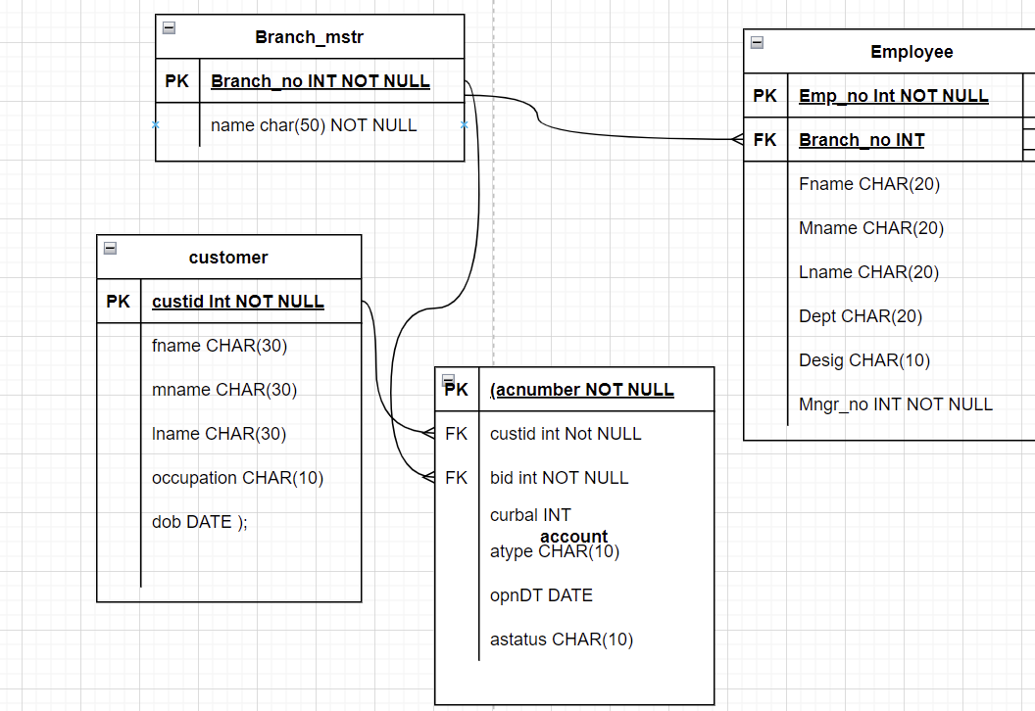
Entity Relationship

Slide 5
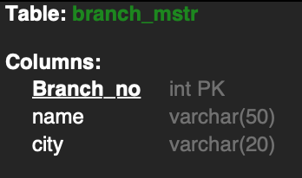
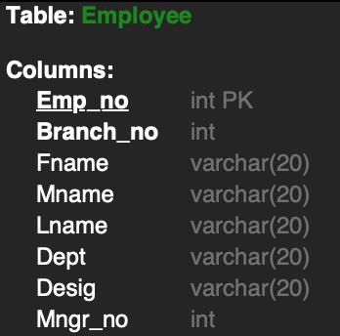
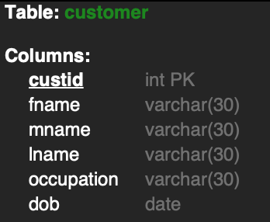
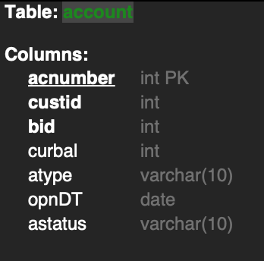

Slide 6

Creating the database

Slide 7
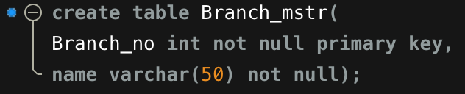
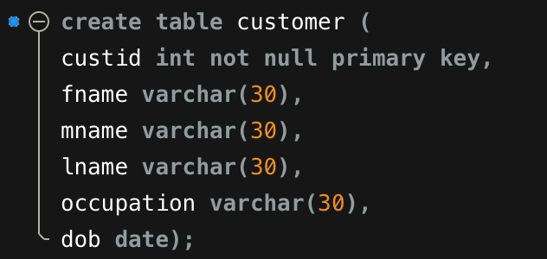
Creating Tables and adding constraints

Slide 8
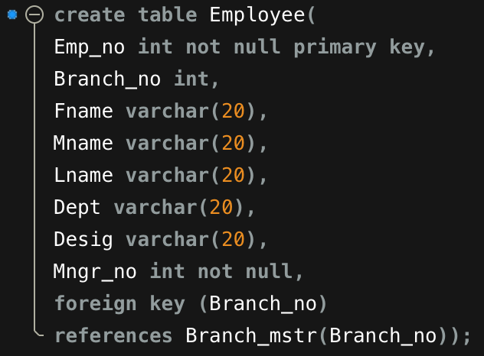

Slide 9
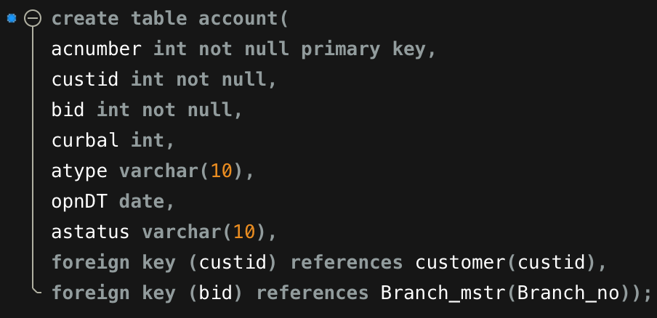

Slide 10

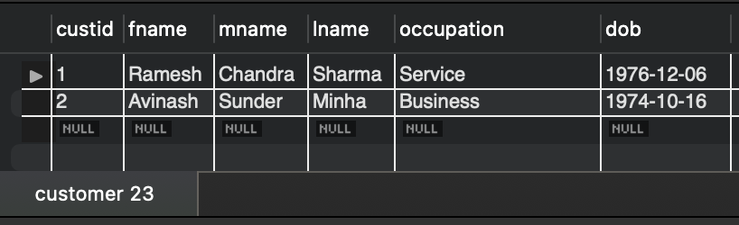
SELECT * FROM customer;

Slide 11
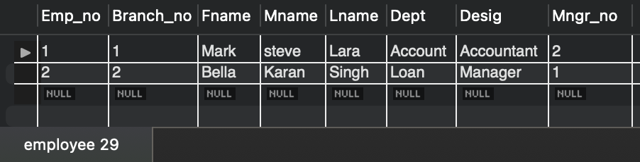
SELECT * FROM Employee;

Slide 12
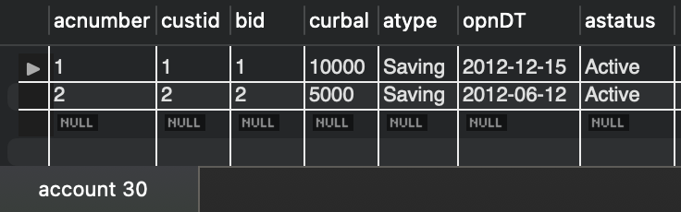
SELECT * FROM account;

Slide 13
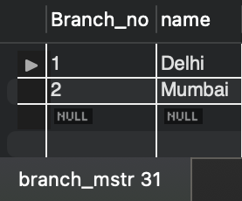
SELECT * FROM branch_mstr;

Slide 14
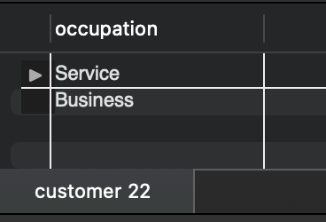
Select unique occupation from customer table
SELECT DISTINCT occupation FROM customer;

Slide 15
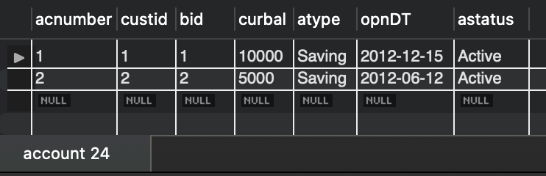
Sorting accounts according to balance
SELECT * FROM account ORDER BY curbal DESC;

Slide 16
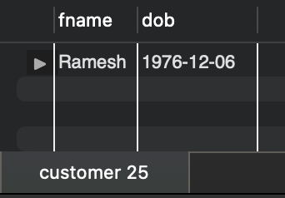
Find the D.O.B. of customer Ramesh
SELECT fname, dob FROM customer WHERE fname LIKE ‘%Ramesh%’;

Slide 17
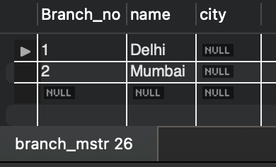
Add column ‘City’ to Branch table
ALTER TABLE branch_mstr ADD COLUMN City VARCHAR(20); SELECT * FROM branch_mstr;

Slide 18
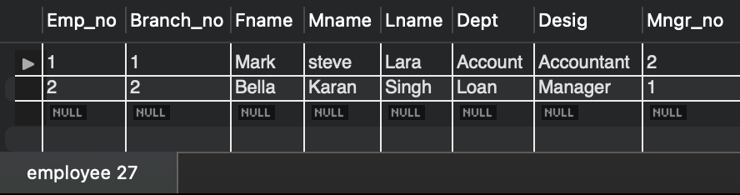
Update Bella’s name to Karan Singh
SET sql_safe_updates=0; UPDATE employee SET mname = ‘Karan’, lname = ’Singh’ WHERE fname = ‘Bella’; SET sql_safe_updates=1; SELECT * FROM employee;

Slide 19
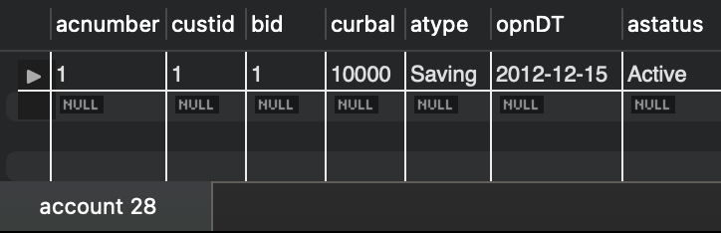
Accounts opened between dates '2012-07-01' AND '2013-01-01'
SELECT * FROM account WHERE opnDT between '2012-07-01' AND '2013-01-01';

Slide 20
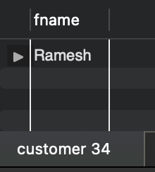
Customers having ‘a’ as second letter in their name
SELECT fname FROM customer WHERE fname like ‘_a%’;

Slide 21
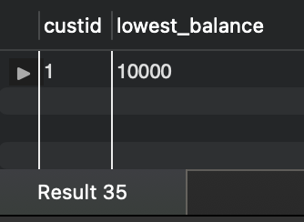
Find the lowest balance from customer & account
SELECT a.custid, min(curbal) as lowest_balance FROM account a JOIN customer c ON a.custid = c.custid GROUP BY a.custid LIMIT 1;

Slide 22
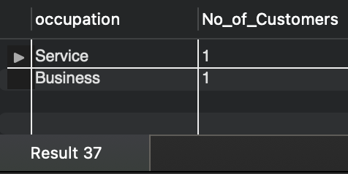
Count of Customers in each occupation
SELECT occupation, count(occupation) as No_of_Customers FROM customer GROUP BY occupation;

Slide 23
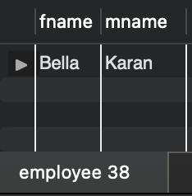
Name of employees who are managers
SELECT fname, mname FROM employee WHERE desig LIKE '%manager%';

Slide 24
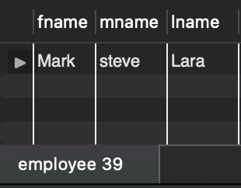
Employees whose names end with ‘a’
SELECT fname, mname, name FROM customer WHERE lname LIKE ‘%a’;

Slide 25
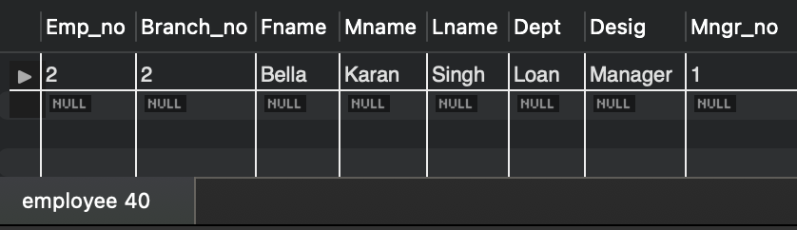
Employees who work for ‘loan’ or ‘credit’ dept.
SELECT * FROM employee WHERE dept = 'loan' OR dept='credit';

Slide 26
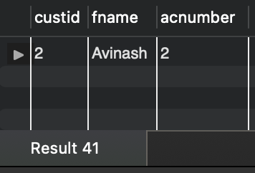
Customers who are born after 15th of any month?
SELECT c.custid, c.fname, a.acnumber FROM customer c JOIN account a ON c.custid=a.custid WHERE day(c.dob) > 15;

Slide 27
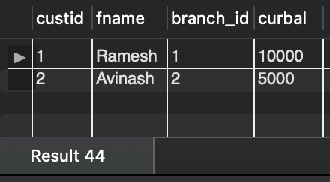
Display Number, firstname, branch id and balance
SELECT c.custid, c.fname, a.bid AS branch_id, a.curbal FROM customer c JOIN account a ON c.custid=a.custid;

Slide 28
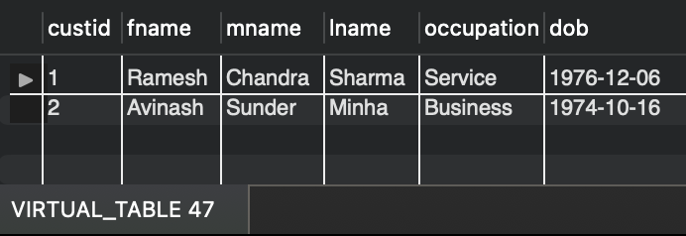
Create a virtual table to store the customers who are having the accounts in the same city as they live?
CREATE VIEW VIRTUAL_TABLE AS (SELECT * FROM customer WHERE custid IN (SELECT custid FROM account WHERE bid IN (SELECT bid FROM branch_mstr)));
SELECT * from VIRTUAL_TABLE;

Slide 29
Create a transaction table with following details
TID – transaction ID – Primary key with autoincrement
Custid – customer id (reference from customer table)
account_no – account number (references account table)
bid – Branch id – references branch table
amount – amount in numbers
type – type of transaction (Withdraw or deposit)
DOT - date of transaction

Slide 30
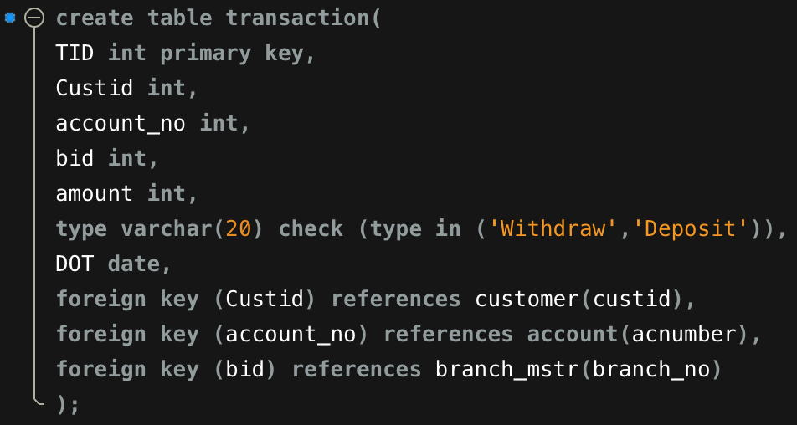

Slide 31
Write a trigger to update balance in account table on Deposit or Withdraw in transaction table
Steps:
Use Delimiter function.
Create a trigger for each insertion on transaction table.
Use conditional statements for identifying Deposit or Withdraw.
Use DML commands to Update and Set the new values.

Slide 32
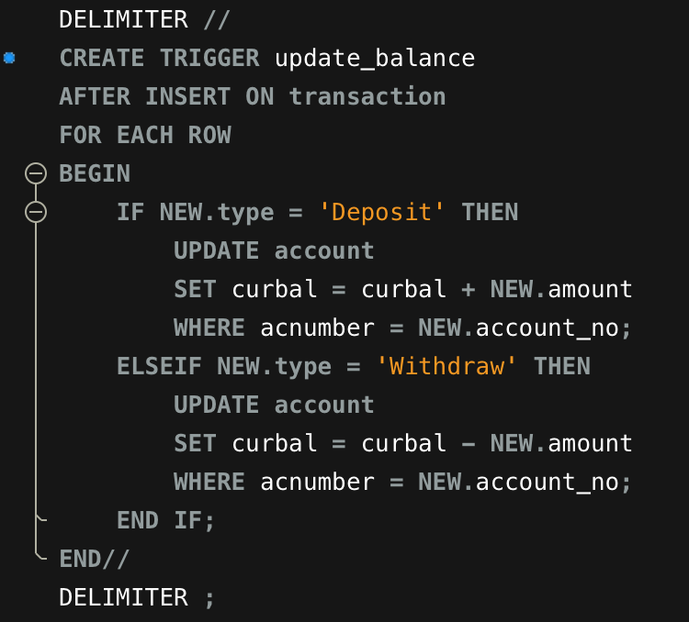

Slide 33
Insert values in transaction to show trigger success
INSERT INTO transaction(tid,custid,account_no,bid,amount,type,DOT) VALUES (1,1,1,1,1000,'Deposit','2023-02-03'), (2,2,2,2,3000,'Withdraw','2023-02-03');
INSERT INTO transaction(tid,custid,account_no,bid,amount,type,DOT) VALUES (3,1,1,1,1500,'Withdraw','2023-02-03'), (4,2,2,2,7000,'Deposit','2023-02-03');

Slide 34
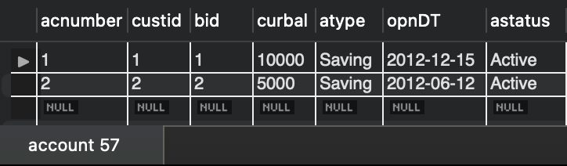
Account balances before initiating Transaction

Slide 35
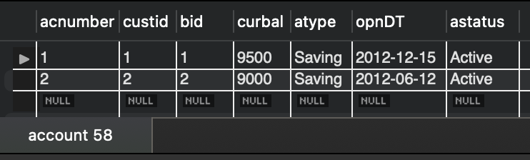
Account balances after initiating Transaction

Slide 36
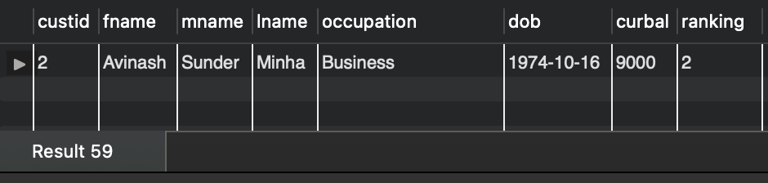
Display customer details with 2nd highest balance?
SELECT * FROM (SELECT *, RANK() OVER(ORDER BY a.curbal desc) AS ranking FROM (SELECT c.custid, c.fname, c.mname, c.lname, c.occupation, c.dob, a.curbal FROM customer c JOIN account a ON c.custid=a.custid) t ) tt WHERE ranking=2;

Slide 37
Finally, Take backup of the database created

Slide 38

Customer Schema Case Study
Create database ‘casestudy’ with given commands and run all lines of code

Slide 39
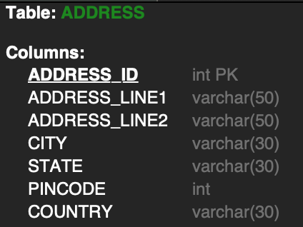
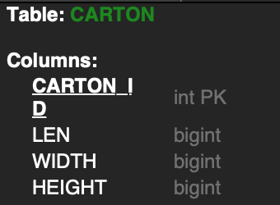
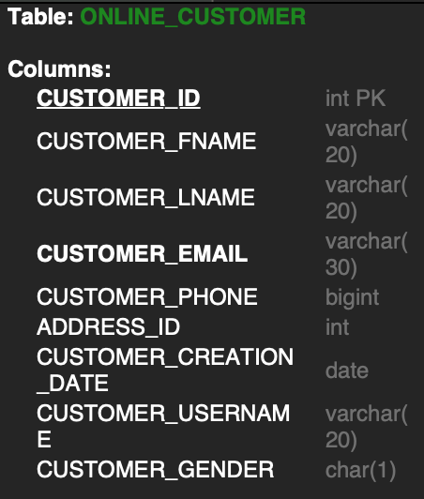
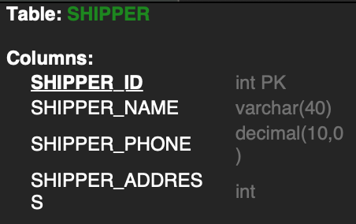

Slide 40
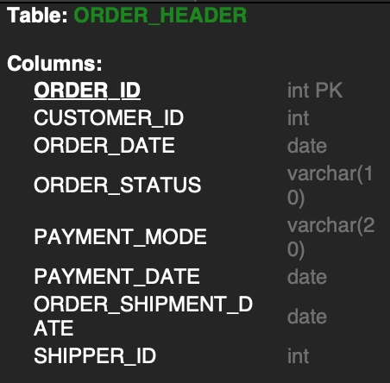
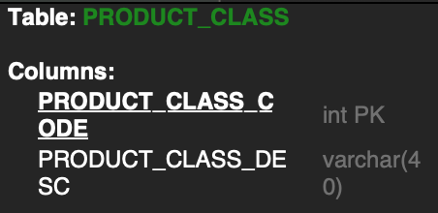
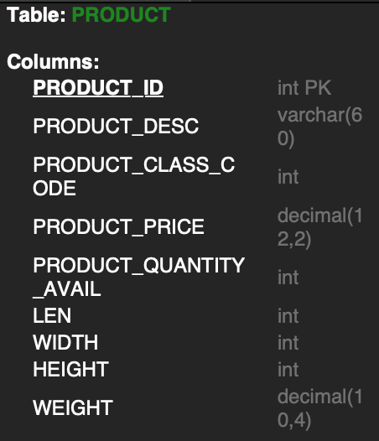
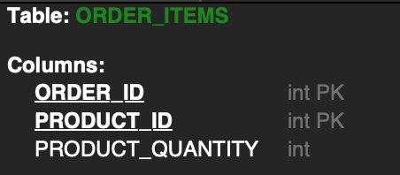

Slide 41
Display the product details as per below criteria and sort them in descending order of category:
1. If the category is 2050, increase the price by 2000
2. If the category is 2051, increase the price by 500.
3. If the category is 2052, increase the price by 600

Slide 42
SELECT product_desc, product_class_code, (CASE WHEN product_class_code = 2050 THEN product_price+2000 WHEN product_class_code = 2051 THEN product_price+500 WHEN product_class_code = 2052 THEN product_price+600 END) New_price FROM product WHERE product_class_code IN (2050,2051,2052) ORDER BY product_class_code DESC;

Slide 43
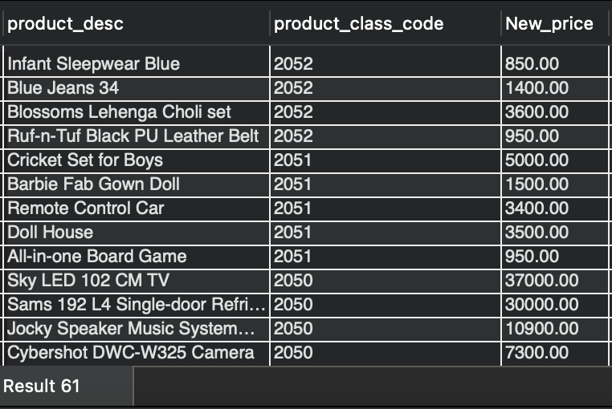

Slide 44
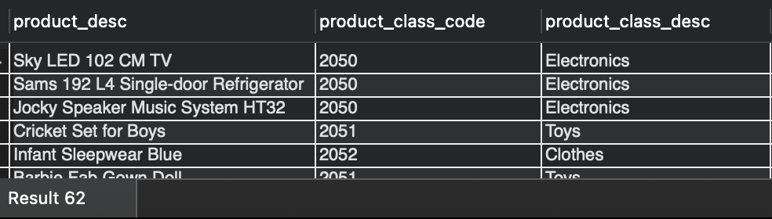
List the product description, class description and price of all products which are shipped.
SELECT p.product_desc, p.product_class_code, pc.product_class_desc FROM product p JOIN product_class pc ON p.product_class_code = pc.product_class_code WHERE p.product_id IN (SELECT product_id FROM order_items);

Slide 45
Show inventory status of products as below as per their available quantity:
For Electronics and Computer categories, if available quantity is < 10, show 'Low stock', 11 < qty < 30, show 'In stock', > 31, show 'Enough stock'
or Stationery and Clothes categories, if qty < 20, show 'Low stock', 21 < qty < 80, show 'In stock', > 81, show 'Enough stock'
Rest of the categories, if qty < 15 – 'Low Stock', 16 < qty < 50 – 'In Stock', > 51 – 'Enough stock'
For all categories, if available quantity is 0, show 'Out of stock'.

Slide 46
SELECT distinct p.product_desc, p.product_quantity_avail, (CASE WHEN pc.product_class_desc like '%Electronics%' or pc.product_class_desc like '%Computer%' and p.product_quantity_avail <= 10 THEN 'Low Stock' WHEN pc.product_class_desc like '%Electronics%' or pc.product_class_desc like '%Computer%' and p.product_quantity_avail between 11 and 30 THEN 'In Stock' WHEN pc.product_class_desc like '%Electronics%' or pc.product_class_desc like '%Computer%' and p.product_quantity_avail > 31 THEN 'Enough Stock' WHENpc.product_class_desc like '%Electronics%' or pc.product_class_desc like '%Computer%' and p.product_quantity_avail = 0 THEN 'Out of Stock' WHEN pc.product_class_desc like '%Stationery%' or pc.product_class_desc like '%Clothes%' and p.product_quantity_avail <= 20 THEN 'Low Stock' WHEN pc.product_class_desc like '%Stationery%' or pc.product_class_desc like '%Clothes%' and p.product_quantity_avail between 21 and 80 THEN 'In Stock' WHEN pc.product_class_desc like '%Stationery%' or pc.product_class_desc like '%Clothes%' and p.product_quantity_avail > 81 THEN 'Enough Stock' WHEN pc.product_class_desc like '%Stationery%' or pc.product_class_desc like '%Clothes%' and p.product_quantity_avail = 0 THEN 'Out of Stock' WHEN pc.product_class_desc not in ('Electronics','Computer','Stationery','Clothes') and p.product_quantity_avail <= 15 THEN 'Low Stock' WHEN pc.product_class_desc not in ('Electronics','Computer','Stationery','Clothes') and p.product_quantity_avail between 16 and 50 THEN 'In Stock' WHEN pc.product_class_desc not in ('Electronics','Computer','Stationery','Clothes') and p.product_quantity_avail > 51 THEN 'Enough Stock' WHEN pc.product_class_desc not in ('Electronics','Computer','Stationery','Clothes') and p.product_quantity_avail = 0 THEN 'Out of Stock' end) Inventory_status from product p JOIN product_class pc ON p.product_class_code = pc.product_class_code;

Slide 47
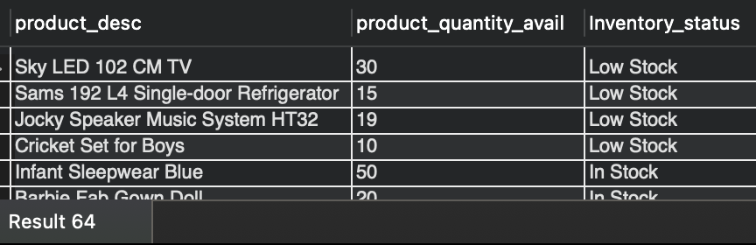

Slide 48
List customers from outside Karnataka who haven’t bought any toys or books
SELECT * FROM online_customer WHERE address_id IN (SELECT address_Id FROM address WHERE state <> 'Karnataka') AND customer_id IN (SELECT customer_id FROM order_header WHERE Order_id IN (SELECT order_id FROM order_items WHERE product_id IN (SELECT product_id FROM product WHERE product_class_code in (SELECT product_class_code FROM product_class WHERE product_class_desc IN ('Toys','Books')))));

Slide 49
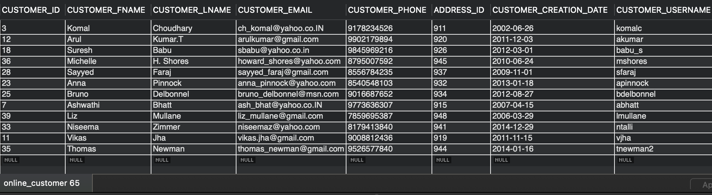

Slide 50
THANK YOU
This presentation is brought to you by:
Mohammed Naveed Navneeth Sankhla Mohamed Ajmal Nirmal Manickam Prakash Abhale

